Slide 1
Top 10 Reasons to learn Computer Science Pete Sanderson (Otterbein University) and Aisling Goodey (Perth College UHI)
____________________________________
____________________________________
____________________________________
____________________________________
____________________________________
____________________________________
____________________________________
____________________________________
____________________________________
____________________________________
Notes:
Do these all at once and then show subsequent slides
There are lots of jobs
High paying jobs (even while you study)
High job satisfaction ratings
Wide diversity of opportunities
Makes your parents happy
An essential part of a well-rounded education
What you study will be applied all over the world
Make a positive difference in the world
Resumé builder for any primary career choice
Collaborative work and individual effort

Slide 2
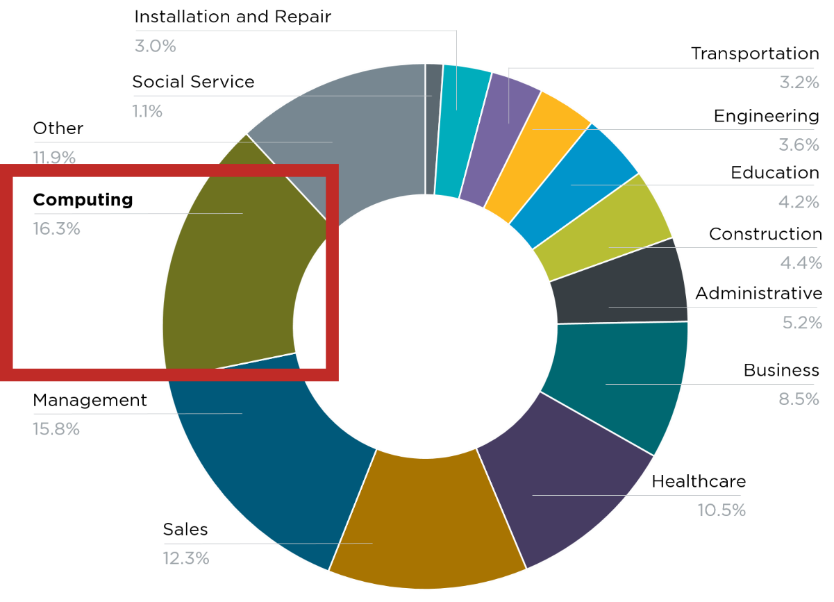
There are lots of jobs: CS is #___ source of new wages in the US
500,000 current openings:
In every industry, every state, projected to grow at _____ the rate of all other jobs.
The picture in Idaho:
______ open computing jobs
_______ CS graduates
____ of high schools teach AP CS
Source: Code.org
Notes:
#1
2x
1,283 open job
435
15% of high schoools

Slide 3
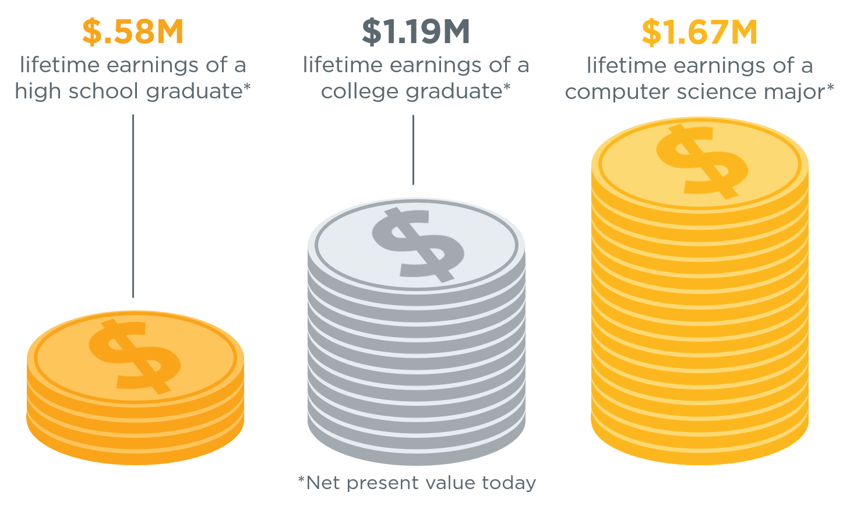
High paying jobs, even as a student
Software Engineers in Pocatello, ID:
Average Starting Salary :
$______________
Source: www.roberthalf.com, May 2019
“You can earn money while you _______”
Source: Brookings
Notes:
A computer science major can earn 40% more than the college average.
80,427
“Study”

Slide 4
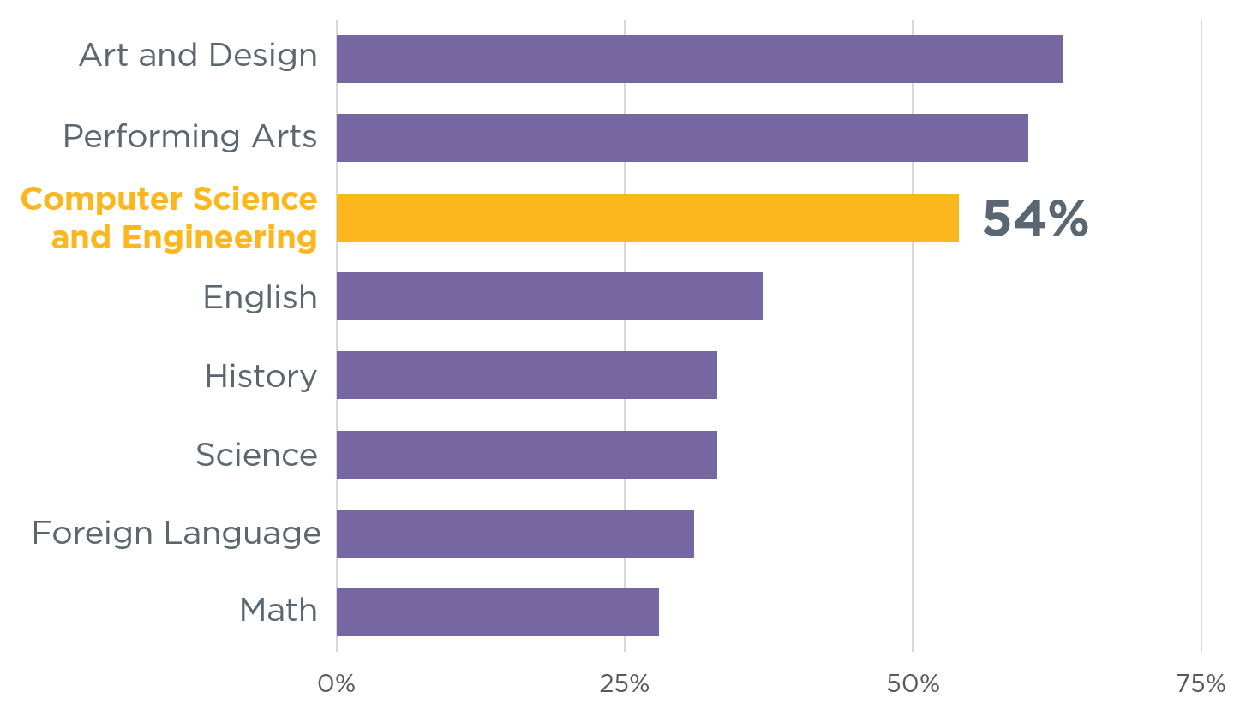
High job satisfaction
“For the second year in a row, software developer takes the
_____ spot as the Best Job overall”
Subjects students like the most:
Source:
U.S. News (U.S. Bureau of Labor Statistics)
Source:
Change the Equation
Notes:
No. 1
Emphasize unemployment rate and work-life balance

Slide 5
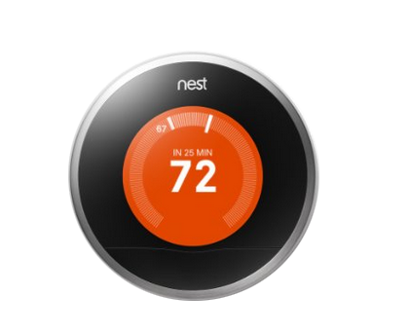
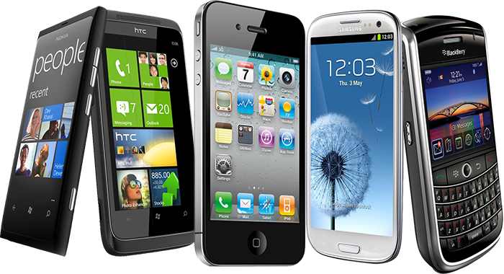
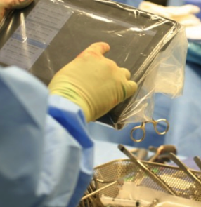
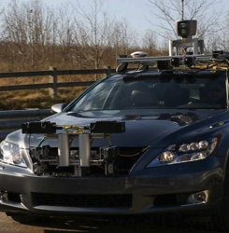
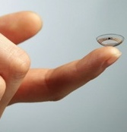
Wide diversity of opportunity
Notes:
The reality is that technology affects every field of commerce
In healthcare – computing is part of operating rooms every day and it is enabling breakthroughs like these contact lenses that detect levels of insulin for people with diabetes
In space – we are depending on a generation of robots to explore where humans cannot now
In our homes -- we are automating everyday things like our heating systems
On our roads – we depend on navigation systems to get us home and now we are experimenting with bringing self-driving cars into our everyday lives
In entertainment – blockbuster movies depend on computer science to bring new characters to life and provide us new completely animated worlds
And every single day this trend is growing across every single industry

Slide 6
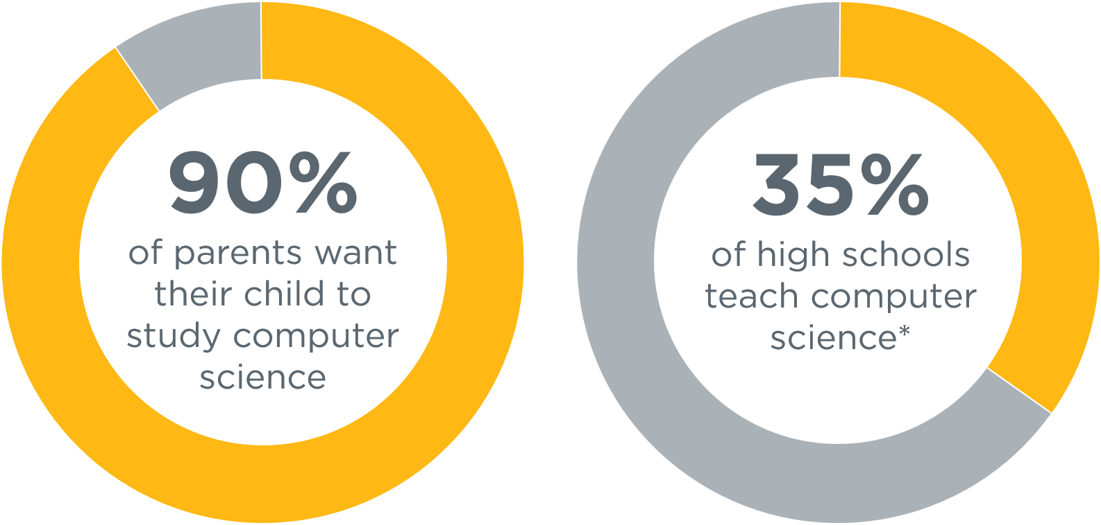
Studying CS makes your parents happy!
Source: Access Report
Code.org
Notes:
90%
But the reality of our education system today is that it is not set up for everyone to participate in the new American economy and opportunity
Computer science isn’t widely taught in our schools
A recently released comprehensive Gallup survey of parents and school administrators shows the stark gap between what parents want and what is happening in our schools
9 out of 10 parents surveyed WANT their child to learn computer science
But according to our Access Report, just 35% of high schools teach computer science courses
Our education system clearly needs to evolve to bring computer science to students that want to learn this subject
And this evolution isn’t something the tech industry wants, it is clearly something that parents and students want

Slide 7
CS is an essential part of a well-rounded education
83% of parents and 64% of principals in rural and small towns
believe offering computer science is more or equally as important as __________________________
Source: Code.org
Notes:
any required course

Slide 8
Notes:
This is how I like to think about it. And it’s true your grad school apartment is going to be small.
I believe grad school gives you phenomenal cosmic powers.

